Slide 1

AIRBNB HOTEL BOOKING ANALYSIS
Kashifa Shah
Internship ID: STU6828a35915ed01747493721

Slide 2

PROBLEM STATEMENT
The rise of online platforms like Airbnb has transformed the hospitality industry, offering travelers diverse lodging options and personalized experiences. However, understanding the factors that influence listing availability, pricing, and customer satisfaction remains challenging for hosts and stakeholders. This study aims to analyze the New York City Airbnb dataset to uncover patterns and insights that can guide better decision-making in short-term accommodation management, optimize pricing strategies, and improve overall guest experience.

Slide 3
Project Description
Airbnb has transformed the hospitality industry by connecting travelers with diverse lodging options, from city apartments to countryside cottages. With growing listings and users, understanding booking patterns, pricing, guest preferences, and host performance is crucial.
Objectives:
Booking Patterns: Identify peak seasons, location-wise trends, and booking lead times.
Pricing Strategies: Examine effective pricing, seasonal impacts, and relation to guest satisfaction.
Guest Preferences: Discover popular amenities, factors for higher ratings, and variation by listing type.
Host Performance: Analyze practices of top hosts, responsiveness, and common guest complaints.
This analysis of NYC Airbnb data aims to uncover insights that help hosts optimize listings, improve guest experience, and support data-driven decision-making in short-term accommodations.

Slide 4

WHO ARE THE END USERS?
Airbnb Hosts
Understand booking trends, optimize pricing, improve listing quality, and increase occupancy and guest satisfaction.
Airbnb Platform / Management
Use insights to enhance platform policies, improve user experience, and support strategic decision-making.
Potential Guests / Travelers
Benefit indirectly through better pricing, improved listings, and personalized lodging experiences.
Hospitality Analysts / Researchers
Use the analysis to study market trends, guest behavior, and the dynamics of short-term rental markets.

Slide 5

Technology Used
Python – Main programming language for data analysis.
Pandas & NumPy – Data cleaning, manipulation, and numerical computations.
Matplotlib & Seaborn – Data visualization for trends, patterns, and insights.
Jupyter Notebook – Interactive coding and documentation.
Excel / CSV – Dataset storage and preprocessing.

Slide 6
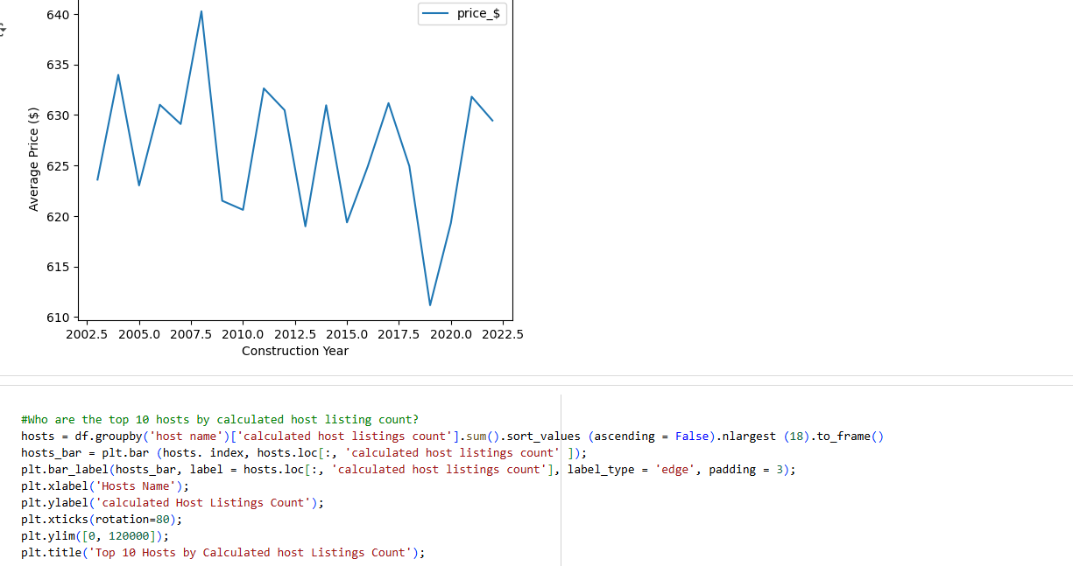
RESULTS1
Demo Link

Slide 7
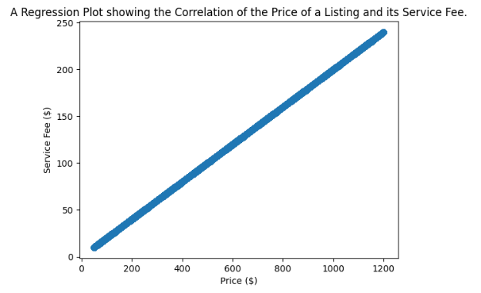
RESULTS2
Demo Link

Slide 8
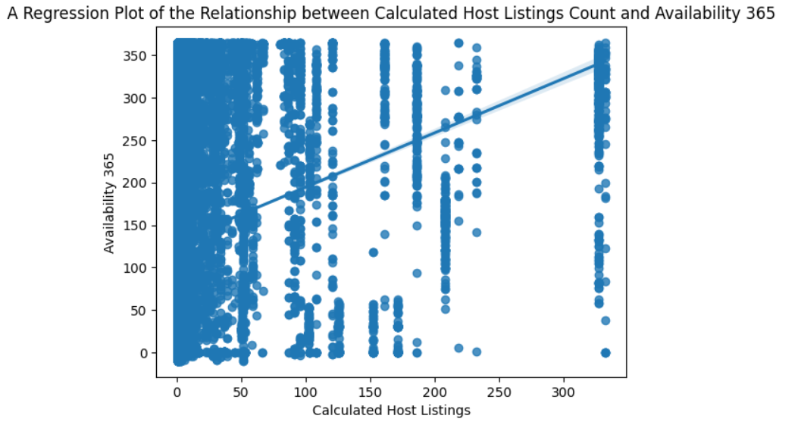
RESULTS3
Demo Link

Slide 9
GitHub repository
https://github.com/kashifashah1/VOIS_AICTE_Oct2025_KashifaShah.git
Demo Link

Slide 10
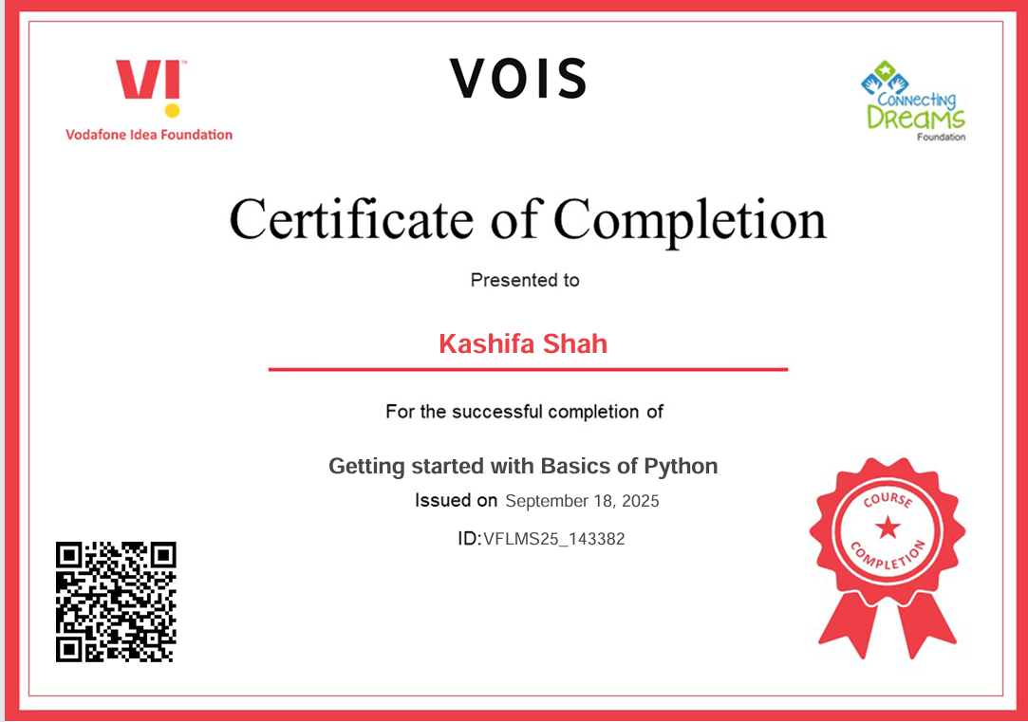
Getting started with Basics of Python Certificate

Slide 11
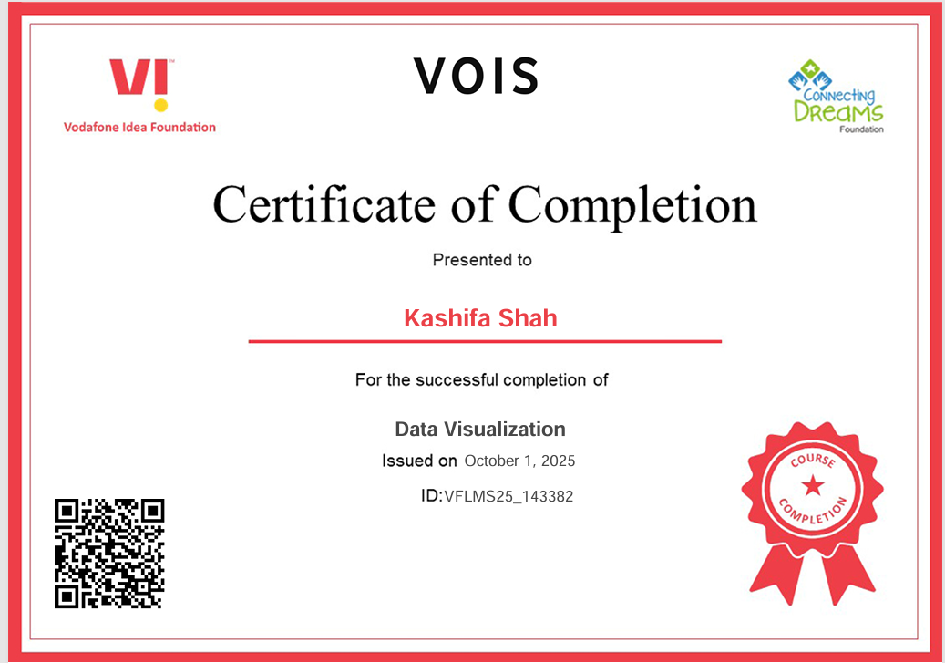
Data Visualization Certificate

Slide 12
Thank you
.
.

